Slide 1
IMPERATIVE PROGRAMMING PARADIGM
Mrs. S. Niveditha
Assistant Professor (Sr. G)
Department of Computer Science and Engineering
SRMIST, Vadapalani Campus

Slide 2
Topics
Program state, instructions to change the program state
Combining Algorithms and Data Structures
Imperative Vs Declarative Programming
Other Languages: PHP, Ruby, Perl, Swift
Demo: Imperative Programming in Python

Slide 3
INTRODUCTION
In a computer program, a variable stores the data. The contents of these locations at any given point in the program’s execution are called the program’s state. Imperative programming is characterized by programming with state and commands which modify the state.
The first imperative programming languages were machine languages.

Slide 4
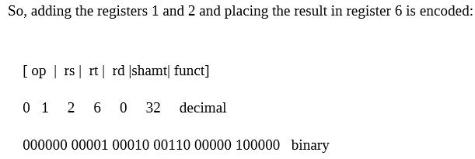
Machine Language
Each instruction performs a very specific task, such as a load, a jump, or an ALU operation on a unit of data in a CPU register or memory. For example:
rs, rt, and rd indicate register operands
shamt gives a shift amount
the address or immediate fields contain an operand directly

Slide 5
Assembly Code
10110000 01100001
Equivalent Assembly code
B0 61
B0 - ‘Move a copy of the following value into AL’ (AL is a register)
61 is a hexadecimal representation of the value 01100001 – 97
Intel assembly language
MOV AL, 61h; Load AL with 97 decimal (61 hex)

Slide 6
Other Languages
FORTRAN (FORmula TRANslation) was the first high level language to gain wide acceptance. It was designed for scientific applications and featured an algebraic notation, types, subprograms, and formatted input/output.
COBOL (COmmon Business Oriented Language) was designed at the initiative of the U. S. Department of Defence in 1959 and implemented in 1960 to meet the need for business data processing applications.
ALGOL 60 (ALGorithmic Oriented Language) was designed in 1960 by an international committee for use in scientific problem solving

Slide 7
Evolutionary developments
Algol to PL /I
Block structure
Control statements
Recursion
PL / I to FORTRAN
Subprograms
Formatted IO
COBOL to PL/I
File manipulation
Record
LISP to PL/I
Dynamic storage allocation
Linked structures

Slide 8
OVERVIEW
In imperative programming, a name may be assigned to a value and later reassigned to another value.
The collection of names and the associated values and the location of control in the program constitute the state.
The state is a logical model of storage which is an association between memory locations and values.
A program in execution generates a sequence of states.
The transition from one state to the next is determined by assignment operations and sequencing commands.

Slide 9
Highlights on
Assignment,
goto commands
structured programming
Command
Statement
Procedure
Control-flow
Imperative language
Assertions
Axiomatic semantics
State
Variables
Instructions
Control structures

Slide 10
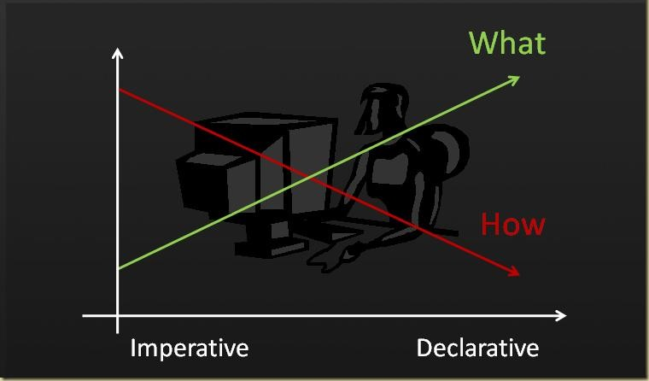
Declarative Vs Imperative

Slide 11


Declarative Vs Imperative
# Declarative # Imperative

Slide 12
DEMO

Slide 13
An algorithm to add two numbers entered by user
Step 1: Start
Step 2: Declare variables num1, num2 and sum.
Step 3: Read values num1 and num2.
Step 4: Add num1 and num2 and assign the result to sum. sum←num1+num2
Step 5: Display sum
Step 6: Stop

Slide 14
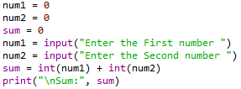

Addition two numbers entered by user

Slide 15
An Algorithm to Get n number, print the same and find Sum of n numbers
Step 1: Start
Step 2: Declare variable sum = 0.
Step 3: Get the value of limit “n”.
Step 4: If limit is reached, goto Step 7 else goto Step 5
Step 5: Get the number from user and add it to sum
Step 6: Goto Step 4
Step 7: If limit is reached, goto Step 9 else goto Step 8
Step 8: Print the numbers
Step 9: Goto Step 7
Step 9: Display sum
Step 10: Stop

Slide 16
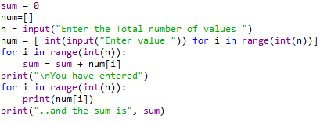
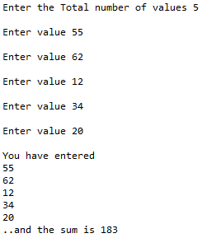

Slide 17



